Slide 1
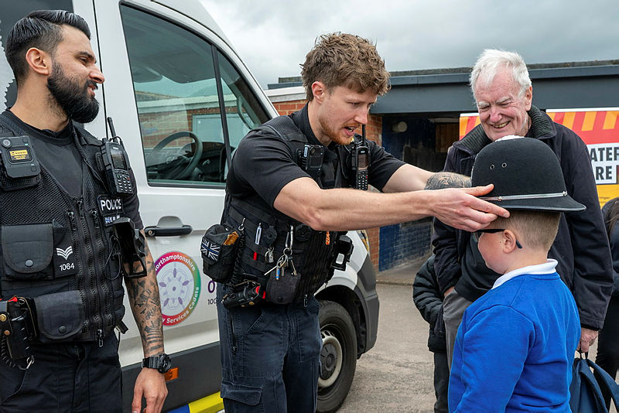
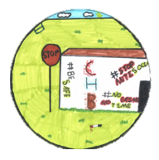
Welcome Croyland residents!
Who are the Clear Hold Build Team?
Northamptonshire Police are dedicated to reducing crime and improving community safety in the Croyland area of Wellingborough. As part of this commitment, we have established a dedicated operation focused on tackling drug-related harm, serious violence, and anti-social
The Clear Hold Build team is a dedicated group of officers committed to supporting the Croyland community. Their presence ensures the area receives a high level of visible foot and mobile patrols each month.
The team are currently in a “CLEAR” phase which involves disrupting offenders, serious organised crime groups and drug lines operating in the area through completing series of arrests, warrants, stop and searches, and using Anti-Social Behavioural powers.
CHB officers are deployed within the community every day to listen to local concerns and work alongside partner agencies to develop and implement effective solutions.
Meet your team
The Clear Hold Build Team are made up of Sergeant Cheema, and officers PC Chambers, PC Desborough, and PC Richardson.
The next monthly Beat Bus surgery will take place on:
📅 Thursday 17 September 2026
🕝 2:30pm to 4:30pm
📍 Priory Road, Wellingborough
August 2026

Slide 2
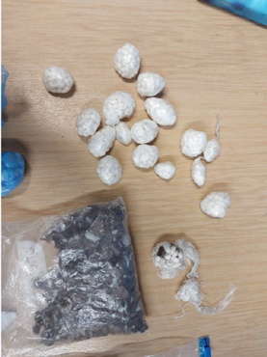

Croyland Updates
August 2026 updates
Between April 2026 and July 2026, the team have spent 387.37 hours patrolling the Croyland Estate. This equates to approximately 96 hours of patrol time per month, making the Croyland Estate one of the areas with the highest levels of police visibility in the north of the county.
Arrests and Charges
Between April 2026 and August 2026, CHB officers arrested 32 individuals. Of the offences investigated, 54 outcomes resulted in either a charge or an Out of Court Disposal.
These figures demonstrate a strong detection and enforcement rate, helping to hold offenders accountable for their actions.
Remands
Between April 2026 and August 2026, CHB officers successfully secured 12 remands into custody.
This means that those suspects were not released from police custody and instead appeared before the court while being held in custody, providing further protection and reassurance to the local community.
Drug Seizures
Between April 2026 and August 2026, the CHB team seized more than 2,200 wraps of Class A drugs, including cocaine and heroin that had been prepared for street-level supply.
Officers also recovered a significant quantity of cannabis. The estimated street value of the drugs seized is between £10,000 and £20,000.
1278 wraps Cocaine/Heroin seized in August 2026
Officers also recovered a significant quantity of cannabis. The estimated street value of the drugs seized is between £10,000 and £20,000.
Illegal Electric Bikes seized
The CHB team have acted and seized seven illegal electric bikes from suspects.
These suspects have also subsequently been charged for traffic related offences.
The removal of these bikes has contributed towards a drop in ASB, and risk of harm posed to the public.
Please rate this message and let us know what you thought of this newsletter.
If you have any topics you would like to see in the next issue, please let us know.
August 2026

Slide 3
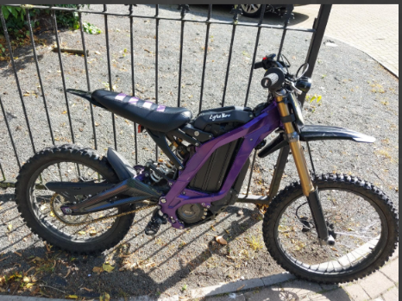
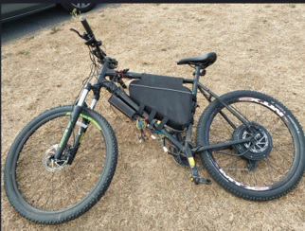
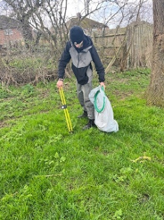
Croyland Updates
• Working with the local authority to ensure all faulty street lighting within Croyland Park was repaired, improving visibility and public safety.
• Delivering a Fearless Crimestoppers campaign across the estate to encourage and educate residents on how to report crime.
• Collaborating with Croyland Primary School, whose pupils designed the Clear Hold Build project logo.
• Securing funding for a further Fearless Crimestoppers programme with local schoolchildren, focusing on crime reporting, knife crime awareness, personal safety, and preventing involvement in criminal activity.
• Working with Housing Associations, to safeguard the vulnerable and evict any problematic residents that pose risk of harm to the community.
Partnership working
We continue to work closely with partner organisations to improve the local area and explore opportunities for CCTV installation within Croyland Park and the use of K-barriers to deter off-road and electric bikes that are causing issues in the area.
Highlights include:
• Referring multiple offenders to the Immediate Justice Team, which has supported community payback projects, including litter-picking activities in Croyland Park.
August 2026

Slide 4
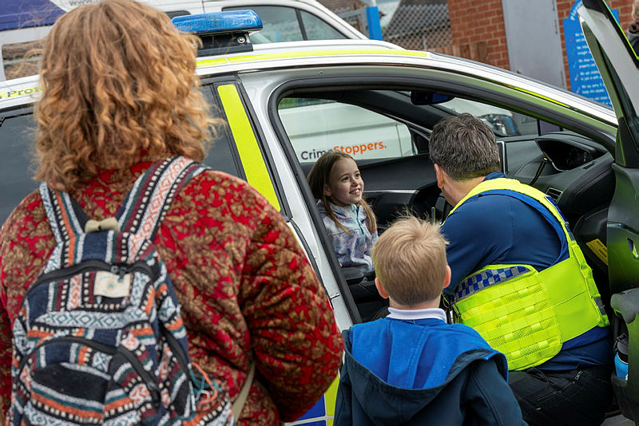
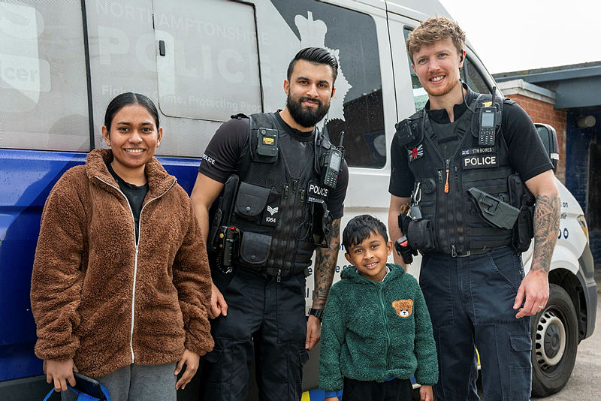
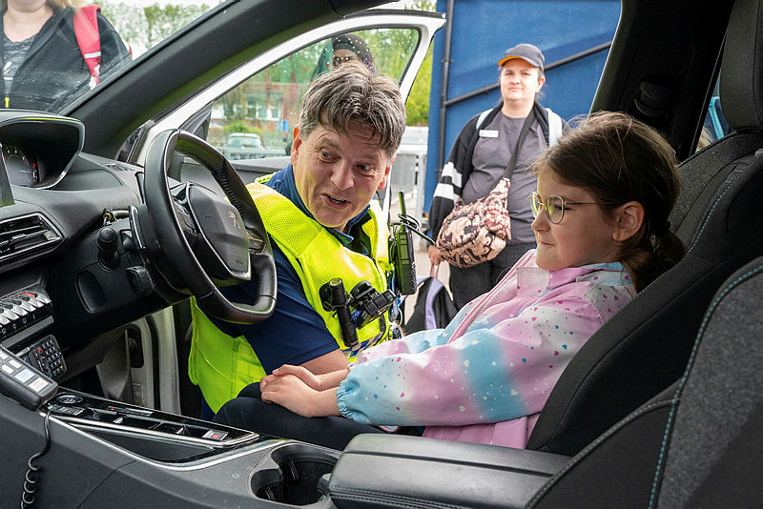
Croyland Updates
Working with Neighbourhood Watch
Since March 2026, the CHB team has hosted monthly Neighbourhood Watch meetings at the Methodist Church on Kingsway, Wellingborough.
These meetings provide residents with an opportunity to speak directly with officers, raise concerns, and discuss issues affecting the community. CHB officers are committed to listening to local residents and working with partner agencies to resolve community concerns.
How can you help?
For us to be as effective as possible, we need your help. If you have information or concerns in relation to any of the above matters, please report them.
There are several methods that you can use to report crime and anti-social behaviour, which includes the ability to report anonymously.
📞 Reports can be made by telephone using 999 in an emergency or 101 in all other cases
💻 Reports can also be made online by visiting www.northants.police.uk and selecting "Report".
Alternatively, you can contact Crimestoppers anonymously by calling 0800 555 111 or reporting online through www.crimestoppers-uk.org.uk.
August 2026

